Slide 1
HALB Fund
Jack Kersting

Slide 2
Philosophy
Econometrics Research Paper : Evolution of CAPM
Betting against Beta
Create a fund that uses stocks with high alphas and low betas in the previous year

Slide 3
Creating the Portfolio
Combining alphas and betas to get weight for stocks
Normalizing CAPM coefficients from previous years to create these weight
Portfolio is set for the year, recreate portfolio every year
Low fees due to passive attribute of fund.

Slide 4
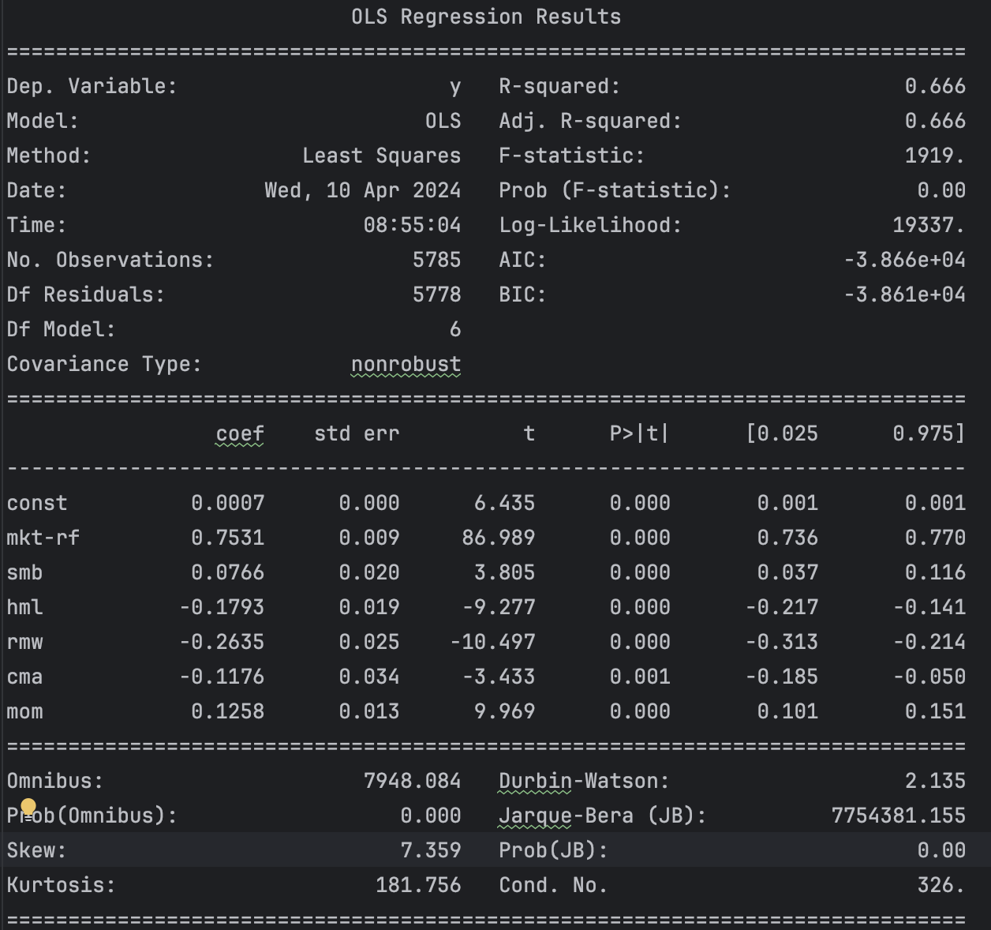
Fund Performance
Run against equally weighted portfolio.

Slide 5
Fund Make Up
Sector Portfolio Performance
Sector | Annualized Alpha | Return Diff. | Beta Diff. | Avg. Weight
Healthcare | 27.7% | 27.8% | -0.272 | 21%
Financial Services | 9.4% | 8.0% | -0.306 | 14%
Industrials | 9.8% | 5.0% | -0.316 | 13%
Basic Materials | 9.3% | 3.0% | -0.428 | 11%
Technology | 8.8% | 3.7% | -0.156 | 9%
Consumer Cyclical | 5.0% | 0.9% | -0.237 | 7%
Energy | 5.6% | 8.0% | -0.326 | 6%
Consumer Defensive | 4.2% | 2.8% | -0.111 | 6%
Real Estate | 6.2% | 3.7% | -0.216 | 5%
Communication Services | 3.1% | 1.3% | -0.139 | 3%
Utilities | 2.3% | 0.5% | -0.129 | 2%

